Slide 1
New York City
Does Bad Weather make it worse?

Slide 2
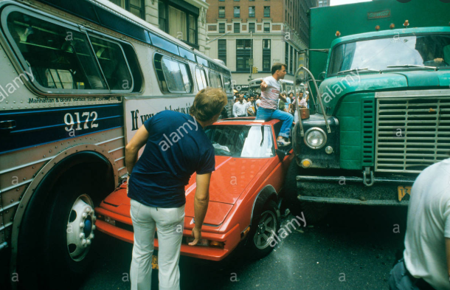

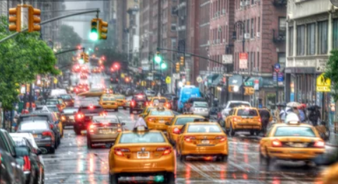
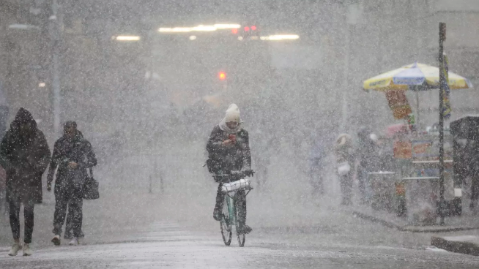
Living in the Big Apple – Does Bad Weather…
…cause more accidents?
…put more folks in cabs?
…cost more to heat your home?

Slide 3
Data Gathering
(The Hardest Part of the Project)

Slide 4
Where to Start?
Air Quality Index
BigQuery
SQL Skills
Got Scary
India Air Quality Index
Only one dataset
Less comparing
Not as rich of a data source
Canadian Political Results with Immigration Changes
Well…
Got too
Political
Endangered Languages comparison to Goodread Dataset
Turns out endangered languages
Don’t write books….
(Might be part of the problem?)

Slide 5
Big City Living
Limited our scope to available datasets and the timeline left in the project
New York
Similar to Toronto
Found Collision Data
Found Weather Data
Found Cab Data
Found Energy Usage Data
This allows for multiple comparisons across datasets with multiple records (100,000 sets in each RAW file min)

Slide 6
Main Data Sources
Kaggle Kaggle Kaggle & data.gov
**Historical Hourly Weather Data 2012-2017**
https://www.kaggle.com/selfishgene/historical-hourly-weather-data
**NYC Cab Trip Duration**
https://www.kaggle.com/c/nyc-taxi-trip-duration
**Hourly Energy Consumption**
https://www.kaggle.com/robikscube/hourly-energy-consumption
**Traffic Collision Data**
https://catalog.data.gov/dataset/traffic-collision-data-from-2010-to-present
Commonality: Date & Hour Data

Slide 7
Data Exploration
Weather Data
No weather data beyond November 2017
Figure of Temperature vs Pressure

Slide 8
Data Exploration
Cab Data – New York
Collision Data
Started out with over 100,000 records from 2016 alone
Cleaned up all “NA” with dropna
10,000 remaining records
90% reduction in data on Step 1 of data cleaning
djd
Energy Data
djd

Slide 9
Data Merging Challenges
Date & Hour Data
All Data Sets Required Same Data Formatting for Merging
Objects versus DateTime
But Date & Time not necessary for Analysis:
Date/Time | Temperature (ºC)
Date/Time | Weather Condition | #Accident
Temperature (ºC) | Weather Condition | #Accident

Slide 10
Weather & Collisions
Does Weather Conditions have an impact on # of collisions that occur?

Slide 11
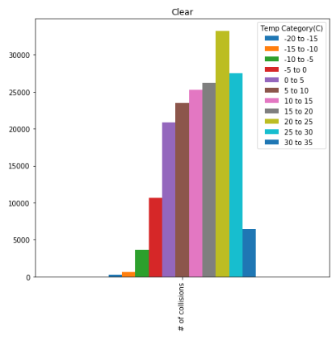
Graph of Clear Day and # Of Collisions
Observations - Higher # of Collisions when the temperature is 20-25C

Slide 12
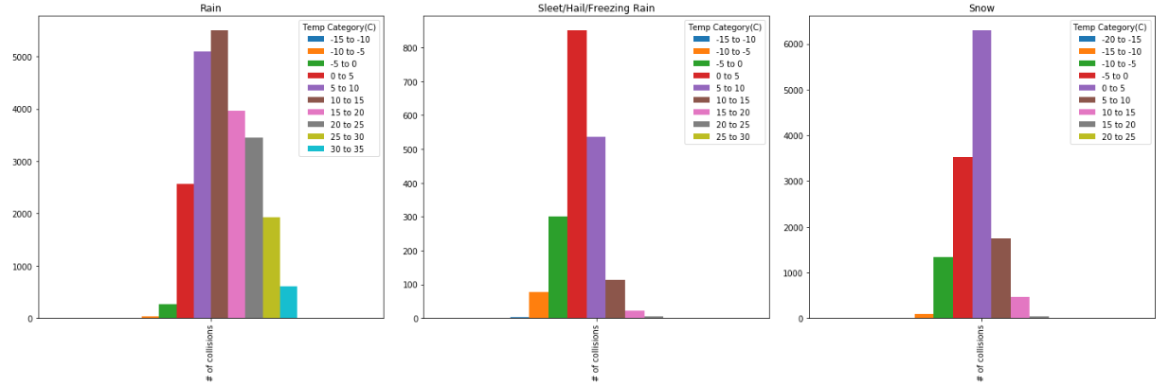
Graphs of Rainy Day, Sleet and Snow Days
Observations – Rainy Days - Higher # of Collisions when the temperature is 5-15C, Where Sleet/Hail/Freezing Rain and Snow have higher # of collisions when the temperature is 0-5C.
When there is precipitation of any sort (Rain/Snow) accidents are likely to occur between 0-15C.

Slide 13
Weather & Cab Rides
Does Weather Conditions have an impact on # of cab rides that occur?

Slide 14
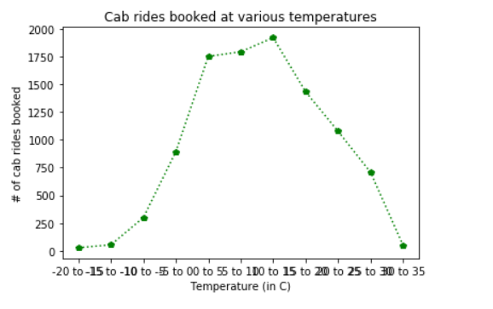
Temperature vs Cab Rides
Observations: Low temperatures didn’t result in high cab rides as initially anticipated, we therefore assume that this must mean that they worked remotely/had a snow day.

Slide 15
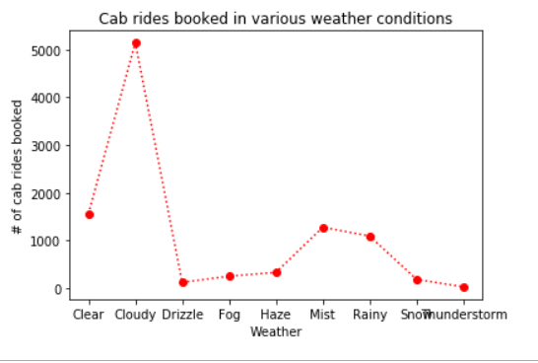
Weather Conditions vs Cab Rides
Observations: Cloudy days correlates with high cab rides

